Slide 1
Total Solar Eclipse
April 8th, 2024

Slide 2
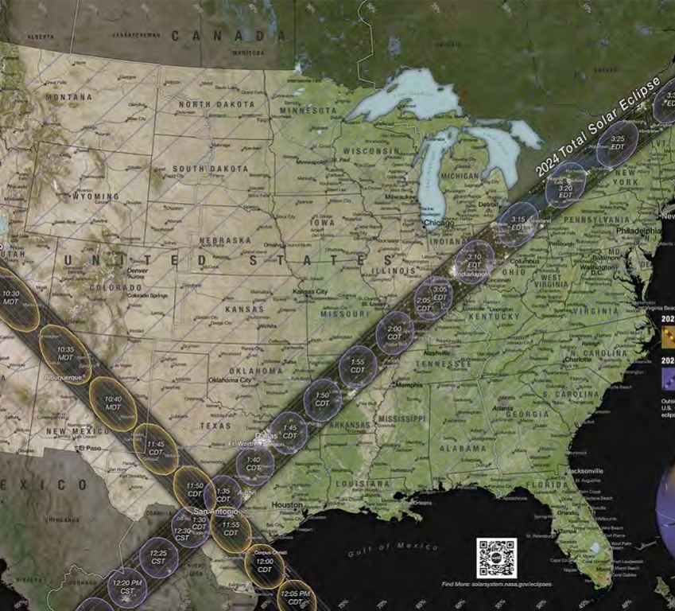
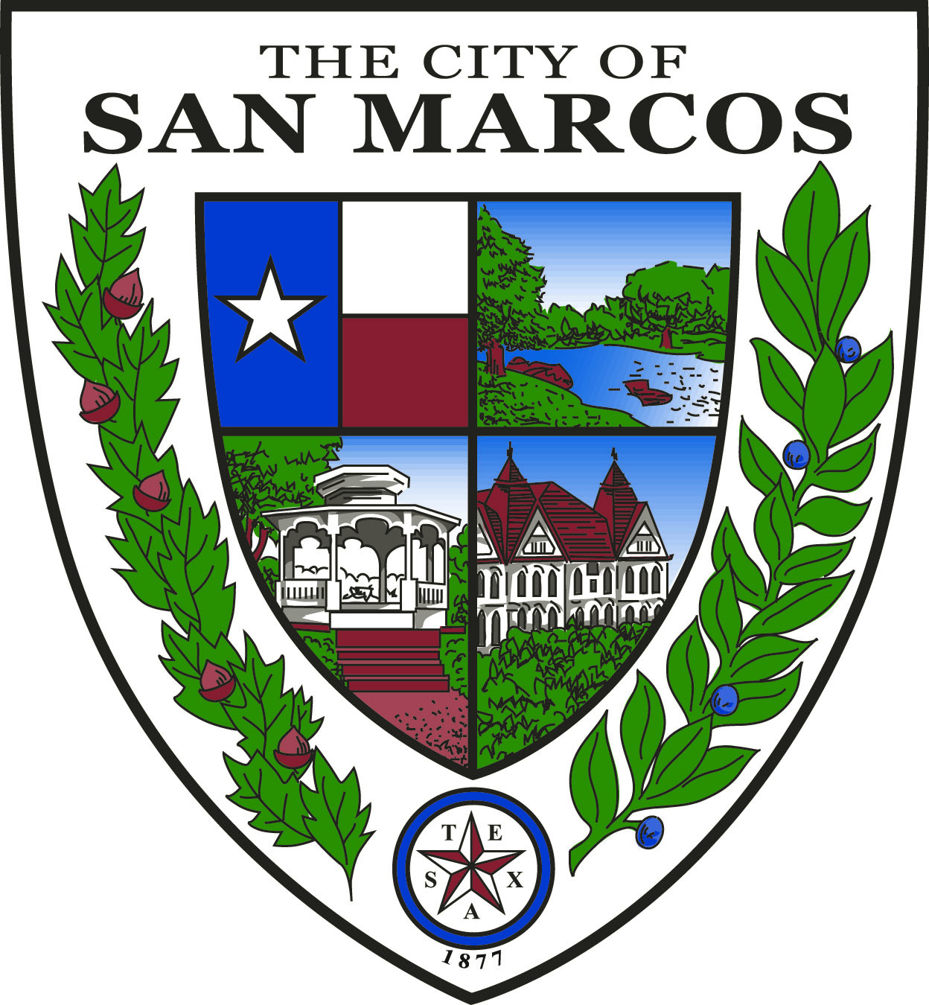
What is an Eclipse?
When the Moon passes between the Earth and the Sun, completely blocking the sun. This passing casts a shadow on the Earth, and only those in the shadow can witness the eclipse.
In October, only part of the Sun was covered – known as an annular solar eclipse.
In April, when the Moon is closest to us, the Sun will be fully covered – known as a total solar eclipse.
Next one will not be until 2045 in the United States

Slide 3
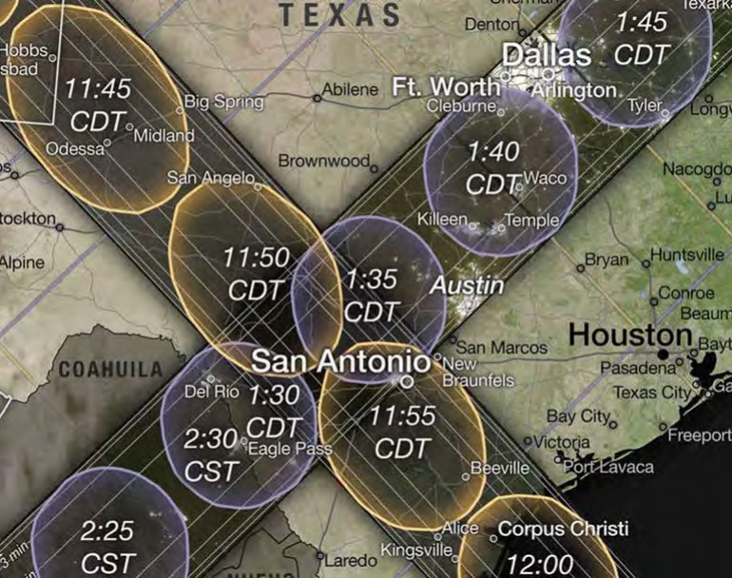
What to Expect
During:
The sky will darken as if it were dawn or dusk
Day Of:
Heavier traffic than usual - Long travel Time (High volume Holiday)
Possible Cellphone Interference
SMCISD will not have class for students.
Possible supply chain interference

Slide 4
What is the City of San Marcos Doing?
Signage will be out across town.
Police and Fire plan to staff up.
Conducted monthly meetings to prepare and plan.
Encouraging telework for staff.
A public facing interactive map has been created by GIS department.
OEM will monitor weather leading up to the event.
Social Media posts will start in coming weeks

Slide 5
Community Engagement
Known public events at Middleton and Roughhouse
TXDOT will be stopping construction 1 day prior.
Peak Wildflower season.
SMCISD will be providing parents with safety information.
Sever Weather Season.
Notes:
Are we reaching out to daycares?

Slide 6
What can YOU do to be prepared?

Slide 7
Things to Think About
Fill or charge vehicles prior to Monday.
Due to influx of people cell service may be spotty.
Consider how you will communicate with employees and vendors if cellular service is down.
Possibly turn on Wi-Fi calling in your settings.
Have manual, or hand-operated, credit card readers ready, if possible.
Consider preparing for cash transactions.
Consider moving shipment days away from Monday if possible.
Download maps if you need to travel.

Slide 8
Protective Eyewear
DO NOT look directly at the Sun without specialized eye protection.
Viewing through a camera or telescope without glasses could also cause severe eye injury.
Suppliers of Safe Solar Viewers & Filters | Solar Eclipse Across America (aas.org)
Who is giving out glasses?
Library at educational events:
3/18 – presentation by a retired university astronomy professor.
3/28 – An educational presentation about eclipses for homeschoolers.
Premium Outlets leading up to the event.

Slide 9
Essential Supplies
Protective Eyewear
Drinking water
Medications for 2-3 days
Mobile phone and charger
First-aid kit
Cash (in case ATMS and credit card machines are down)
Medical bracelets/IDs
Insurance cards
Trash bags
Pets - bring leashes and harnesses, medications, food, water, poop bags, toys
Extra water for overheated cars
Fix a flat kit
Spare tire(s)

Slide 10
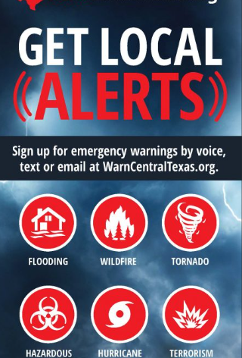
Alert Systems
Everbridge
Warn Central Texas
WarnCentralTexas.org Promo 30-seconds – YouTube

Slide 11
Resources
Solar Eclipse Information | City of San Marcos, TX (sanmarcostx.gov)
NASA - Types of Solar Eclipses - NASA Science
Glasses - Suppliers of Safe Solar Viewers & Filters | Solar Eclipse Across America (aas.org)
For questions, please contact:
City of San Marcos at (512) 393-8000
San Marcos C.I.S.D. at (512) 393-6700
Hays County OEM at (512) 393-7300

Slide 12
Questions?
Bridget La Vigne
Emergency Management Specialist
Email: blavigne@sanmarcostx.gov
Phone: 512-214-5708

